Slide 1
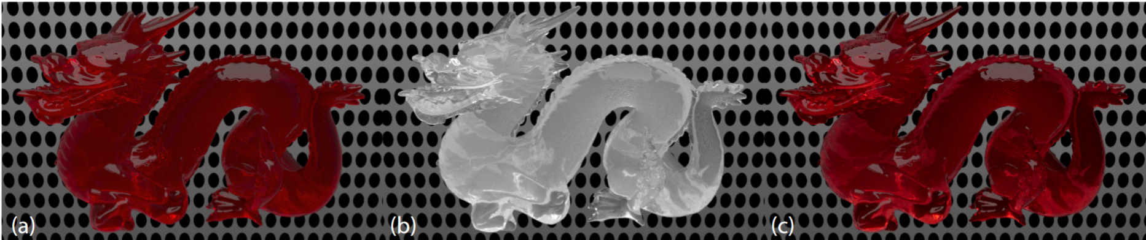
Translucency definition: Challenges
Main issue: Translucency of a material has many influences, such as
Lightness
Wavelength
Forward scattering
Backwards scattering
Viewing conditions (light direction)
Material anisotropies
Scale
This creates a high-dimensional physics problem.
Target of this definition is to reduce the dimensionality of the problem to a single parameter („T“)
that best can describe the degree of perceived translucency.

Slide 2
Desired properties
Define universal definition of degree perceived translucency
Need device-independent calibration methods
Calibration methods should only be based on common color standards
Existing color measurement devices shall
Clearly defined limitations

Slide 3
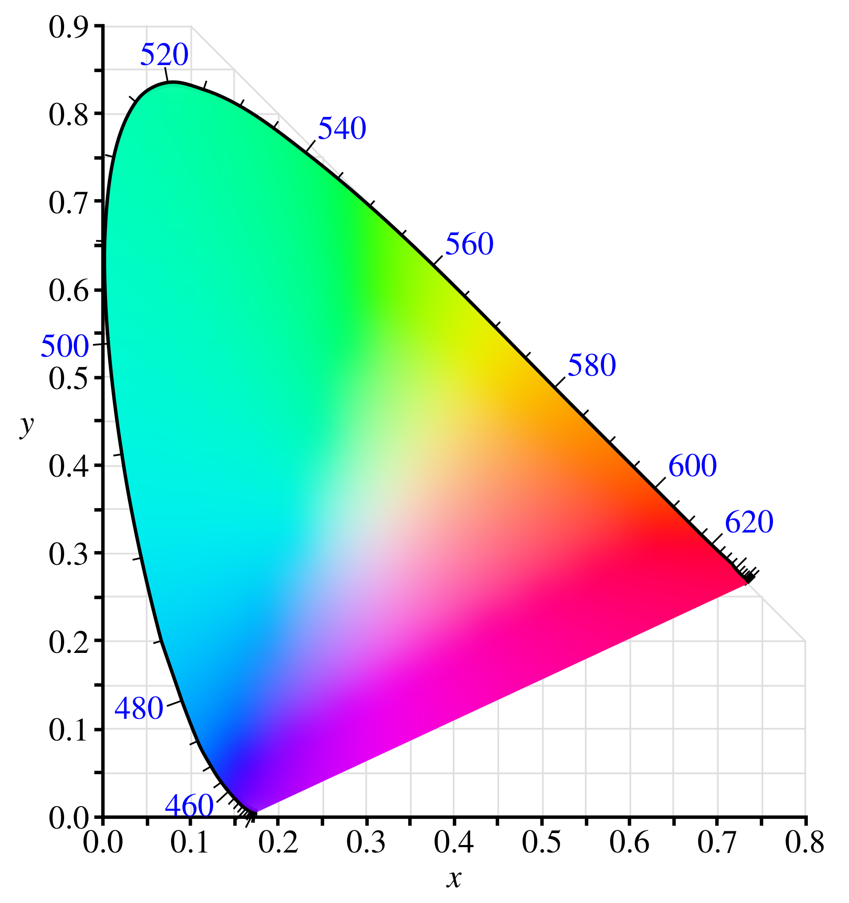
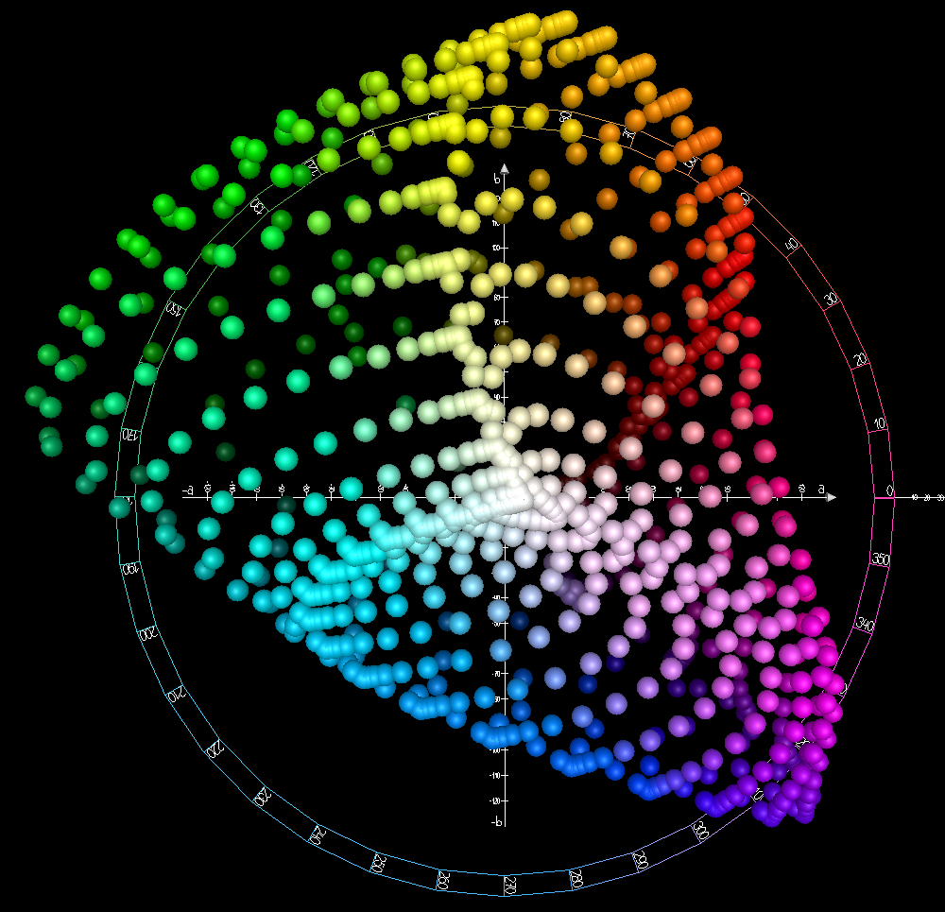
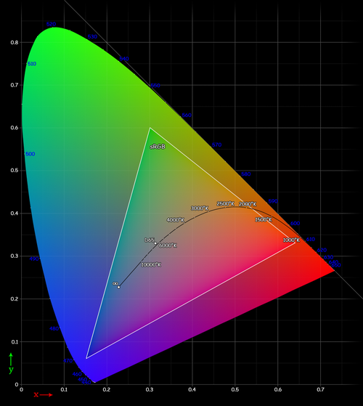
Assumption 1: Influence of colors on translucency.
sRGB color space
CIEXYZ color space
CIELAB color space
(r, g, b)
(x, y, z)
(L*, a*, b*)
L: Lightness
a: green (-) to red (+)
b: blue (-) to yellow (+)
Assumption: The perceived translucency of a material shall only depend on the Lightness L, not on a or b.

Slide 4
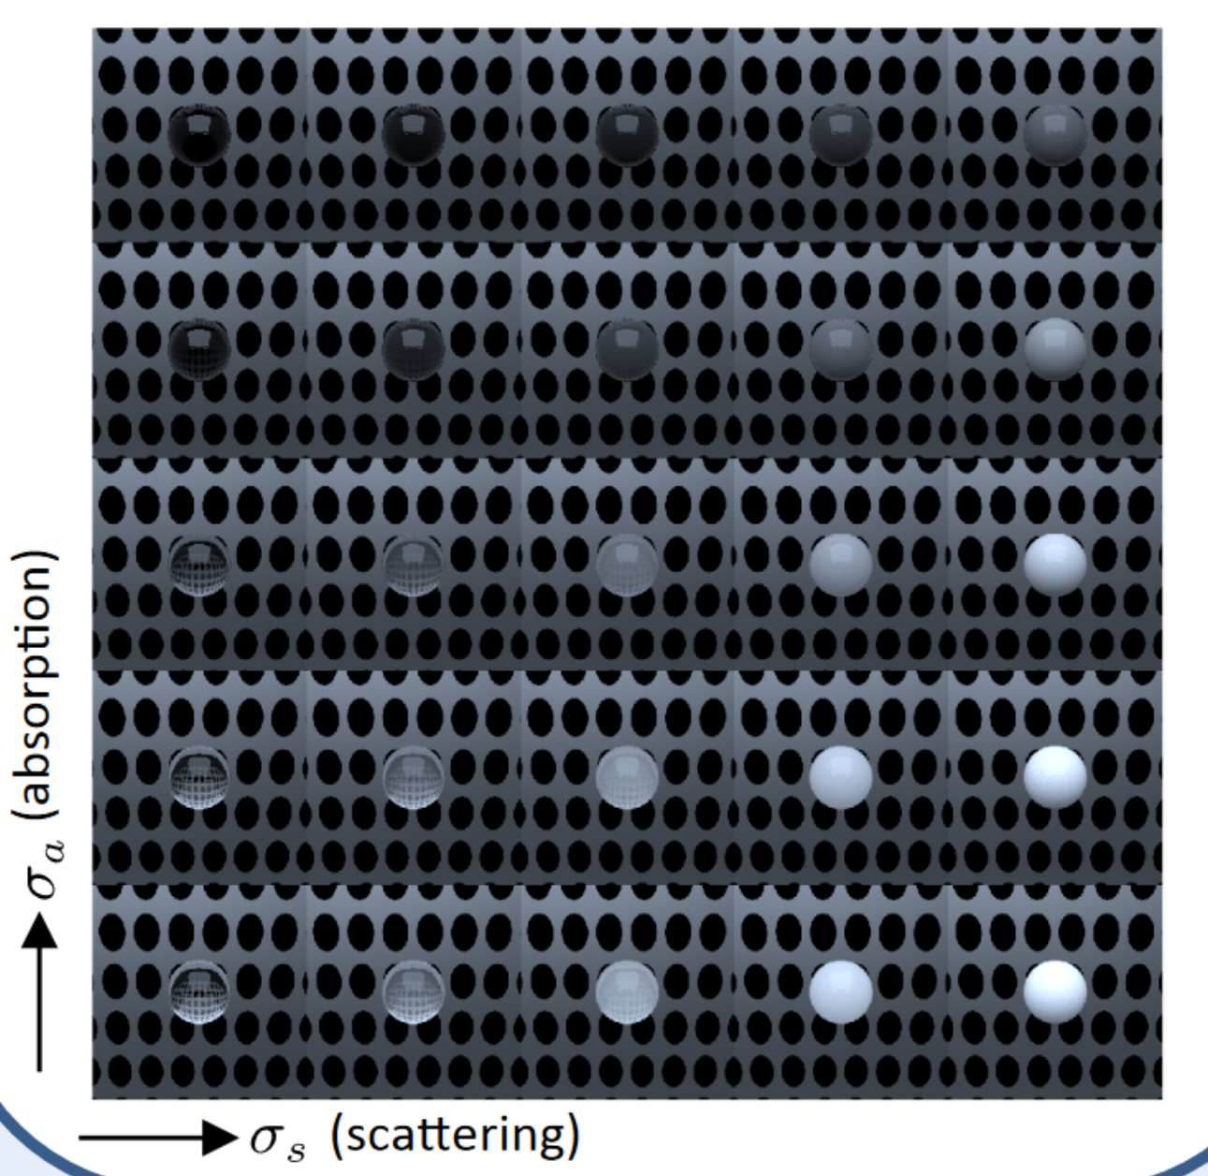
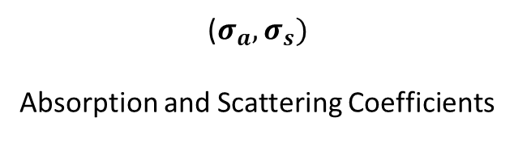
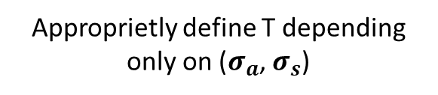
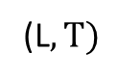
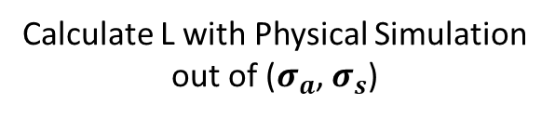
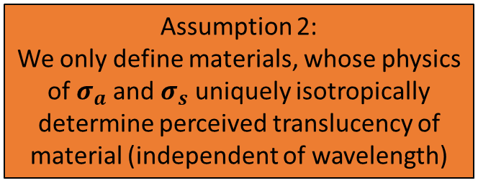
Assumption 2: Physical Model of Isotropic Translucency
Assumption 2:
We only define materials, whose physics of $σ_{a}$ and $σ_{s}$ uniquely isotropically
determine perceived translucency of material (independent of wavelength)
Virtual physical space:
„Translucency space“:
Calculate L with Physical Simulation out of ($σ_{a}$, $σ_{s}$)
For a thickness sample plate of 4 mm
Approprietly define T depending only on ($σ_{a}$, $σ_{s}$)
($σ_{a}, σ_{s})$
Absorption and Scattering Coefficients
For a thickness sample plate of 4 mm
(L$, T)$
Lightness and Translucency
(2-dimensional space)
(2-dimensional space)

Slide 5
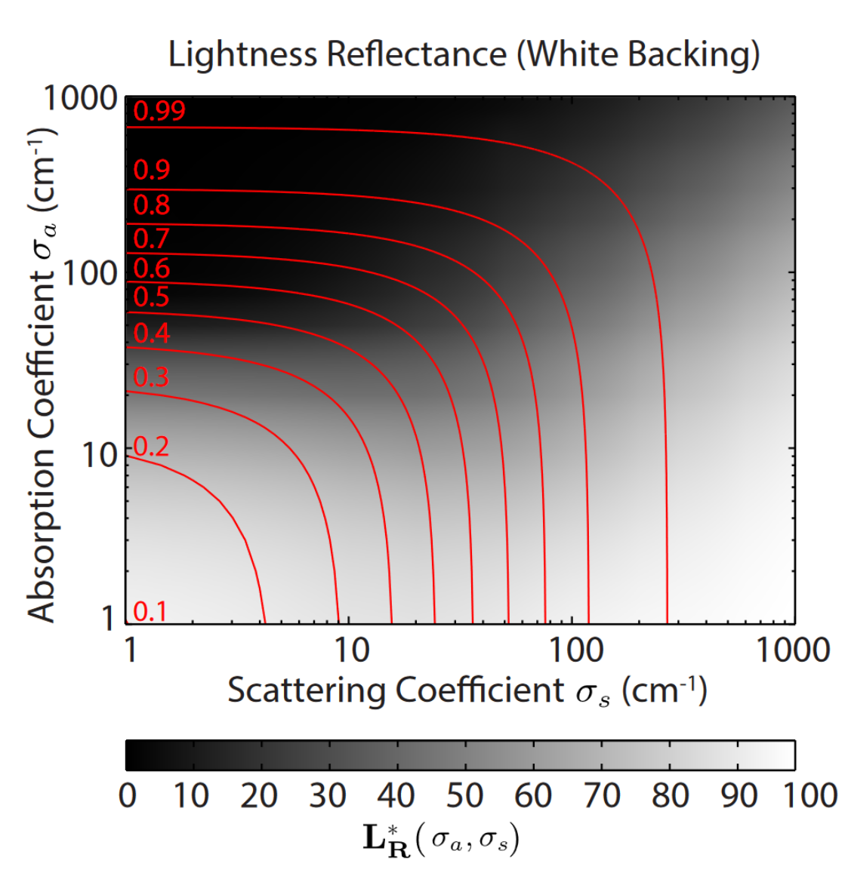
Assumption 3: Perception experiments suggest to define
$$T\left(σ_{a},σ_{s}\right)≔{(1 − e^{−0.0153cm ∗ \left(0.4{ ∗ σ}_{a}+ σ_{s}\right)})}^{0.6}$$

Slide 6
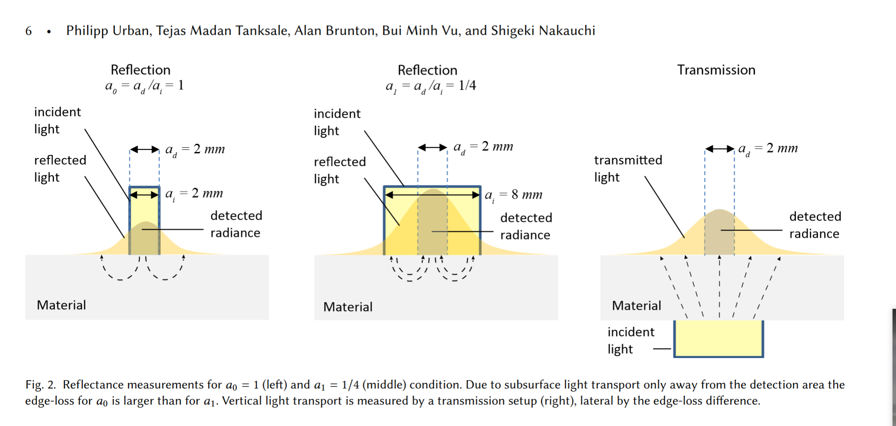
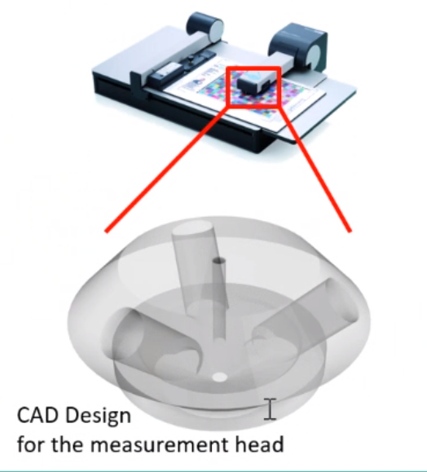
Calibration Process for a real material.
Use Reflectance-Transmission-Spectrometer to measure Reflection with two apartures for illumination and Transmission
Simulate Reflection and Transmission for specific measure aperatures out of physical parameters \sigma_a and \sigma_s. Determine best matching virtual material (\sigma_a, \sigma_s).

Slide 7
Observation
Calibration is depending on the sample thickness and aperatures.
But:
Virtual material definitions are not.
And: For the same measurement aperature, a different sample thickness will give the same mapping
Real Material
Virtual Material

